Slide 1
Lecture 11
AES + Random number

Slide 2
AES pros
all operations can be combined into XOR and table lookups - hence very fast & efficient

Slide 3
Take-home Exercises
Find an AES code to encrypt a text (A), then decrypt it and check whether the original text (A) equals the decrypted text (B). Whether A = B?
Compare the decryption time with different key lengths, and with DES and 3DES.
Suggestions: find a large A file. Run decryption a couple of times and take the average.

Slide 4
Reading materials
FIPS 197, Advanced Encryption Standard (AES) (nist.gov)

Slide 5
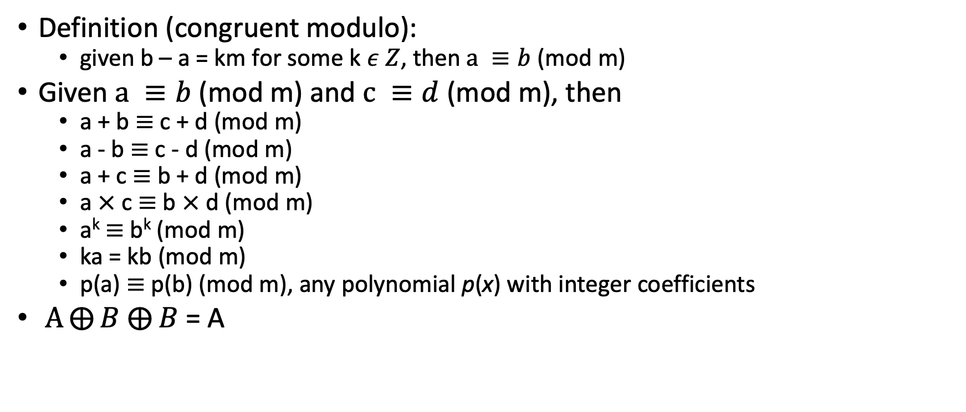
Modular Arithmetic
Definition (congruent modulo):
given b – a = km for some k $ε Z$, then $a ≡b$ (mod m)
Given $a ≡b$ (mod m) and $c ≡d$ (mod m), then
a + b $≡$ c + d (mod m)
a - b $≡$ c - d (mod m)
a + c $≡$ b + d (mod m)
a $×$ c $≡$ b $×$ d (mod m)
a^{k} $≡$ b^{k} (mod m)
ka = kb (mod m)
p(a) $≡$ p(b) (mod m), any polynomial p(x) with integer coefficients
$A⨁{B}$ $⨁{B}$ = A

Slide 6
Random and Pseudorandom Numbers

Slide 7
When to use random numbers?
Generation of a stream key for symmetric stream cipher
Generation of keys for public-key algorithms
RSA public-key encryption algorithm (described in Chapter 3)
Generation of a symmetric key for use as a temporary session key
used in a number of networking applications, such as Transport Layer Security (Chapter 5), Wi-Fi (Chapter 6), e-mail security (Chapter 7), and IP security (Chapter 8)
In a number of key distribution scenarios
Kerberos (Chapter 4)

Slide 8
Two types of random numbers
True random numbers:
generated in non-deterministic ways. They are not predictable and repeatable
Pseudorandom numbers:
appear random, but are obtained in a deterministic, repeatable, and predictable manner

Slide 9
Properties of Random Numbers
Randomness
Uniformity
distribution of bits in the sequence should be uniform
Independence
no one subsequence in the sequence can be inferred from the others
Unpredictable
satisfies the "next-bit test“

